Slide 1

HTU- Point of Sale
By
Abdulrahman Hasan
Notes:
My project for today and From the title we can know the content

Slide 2

Problem Statement
HTU established a store inside King Abdullah Business Park. The IMU in HTU recruited me to build a Point of Sale (POS) web application to handle the store sales transactions and stock. There are many employees with a different role that will work on the POS.
Notes:
What problem does this project solve? So we have to build a POS web application with specific requirements to solve the problem

Slide 3

What is a POS system?
A point of sale, refers to the ‘point’ where a customer makes a purchase and the payment is processed.
In the past, a 'POS system' used to refer to the cash register at a store. Today, modern POS systems are entirely digital, which means you can check your business wherever you are.
Notes:
But before that we have to know what a point of sale system is

Slide 4

Here comes the role of our web Application HTU-POS

Slide 5
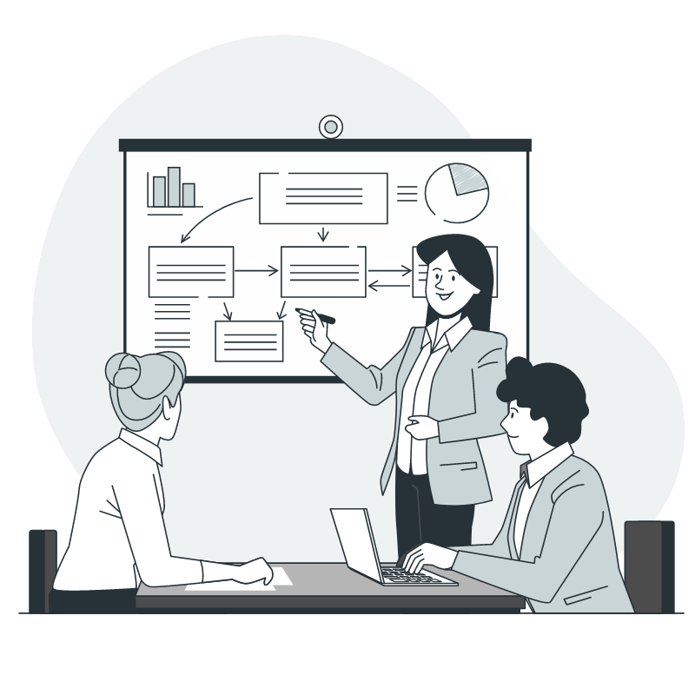
Requirements Analysis
There will be five main pages (views) with different sub-pages in the system:
1- Admin informative dashboard.
2- Users management page.
3- Selling dashboard.
4- Stocks management page.
5- Transactions management page.
Notes:
After reading the SSR file we can conclude that

Slide 6
Requirements Analysis
Also, There will be four main system users with different privileges to access these pages:
1- Administrator: can access all previous pages.
2- Seller: can access only selling dashboard.
3- Procurement manager: can access only stock management page.
4- Accountant: can only access Transactions management page.

Slide 7

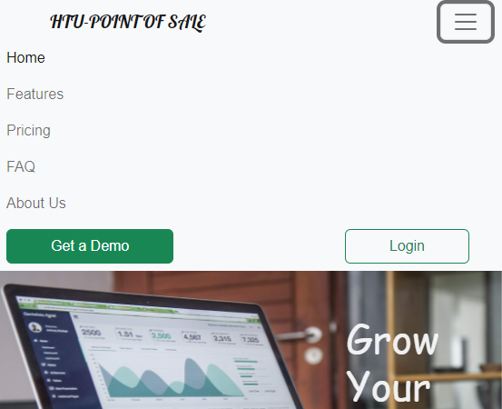
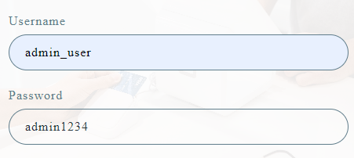
System Features and (GUIs)
htupos.com
Notes:
Before demonstrating the system features and GUIs, my web application is already live on a server if you want to join me in my demo please go to this URL then click the hamburger menu, and login button if you are accessing it from a mobile phone or tablet then enter these login credentials username and password

Slide 8
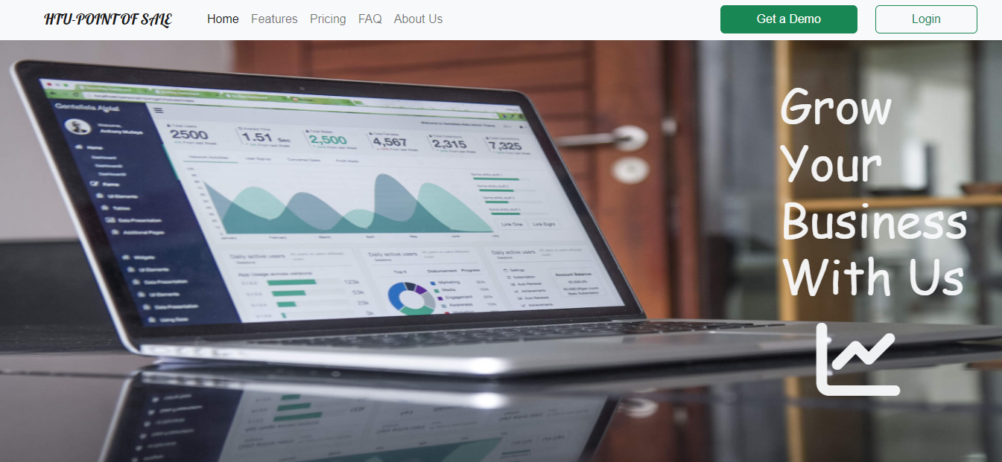
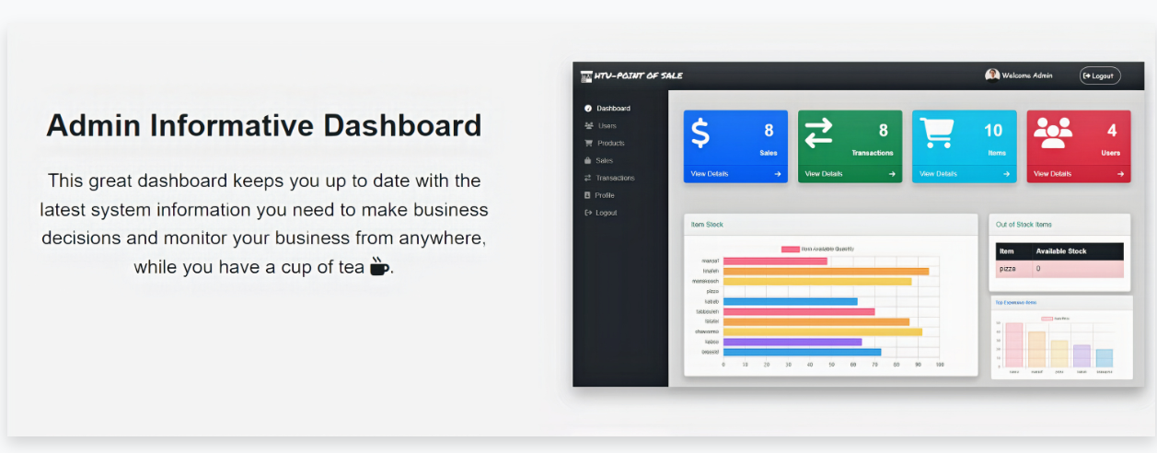
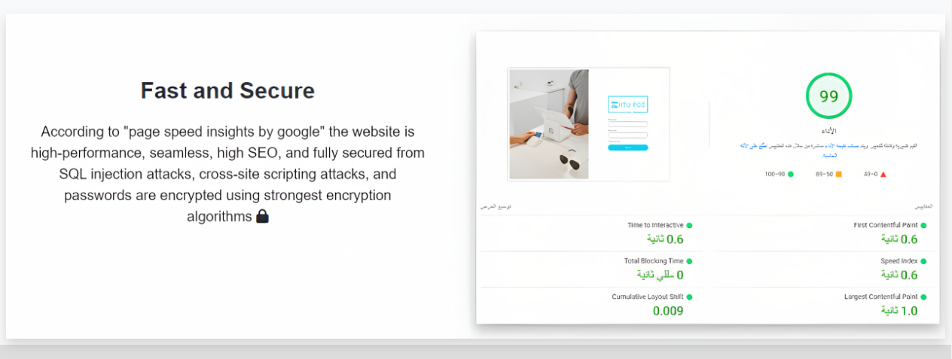
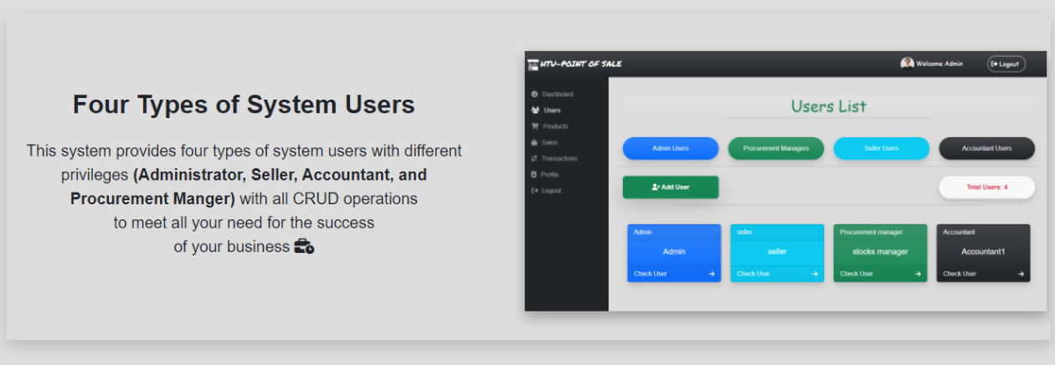
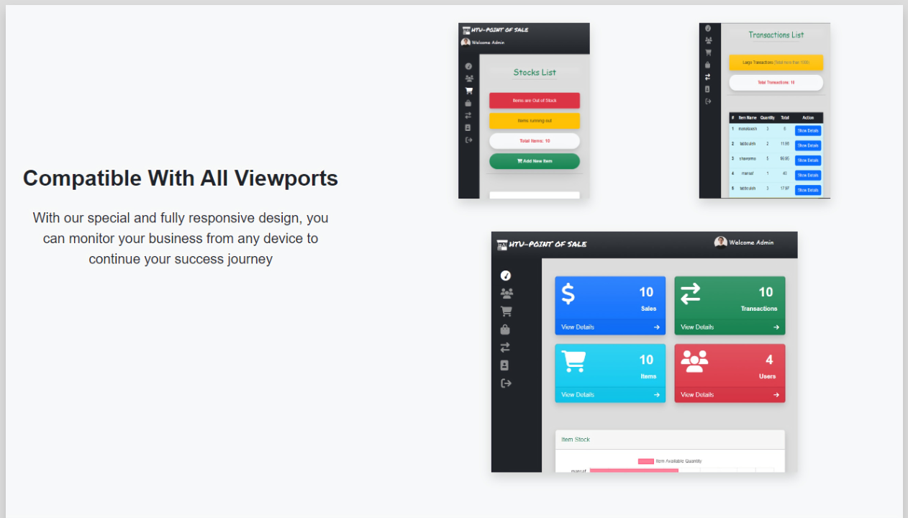
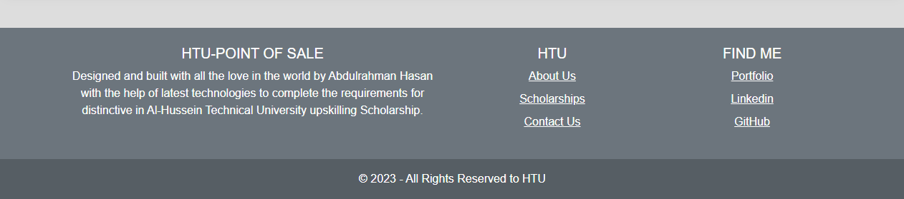
Notes:
Once we accessed the website we can see the landing page which contains a brief about the main features in this web app with pages snapshots. and by the way this page is an additional page it’s not (one of the requirements), I have made this page to be an informational page about the system.

Slide 9
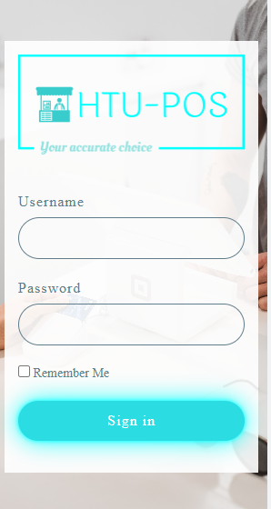
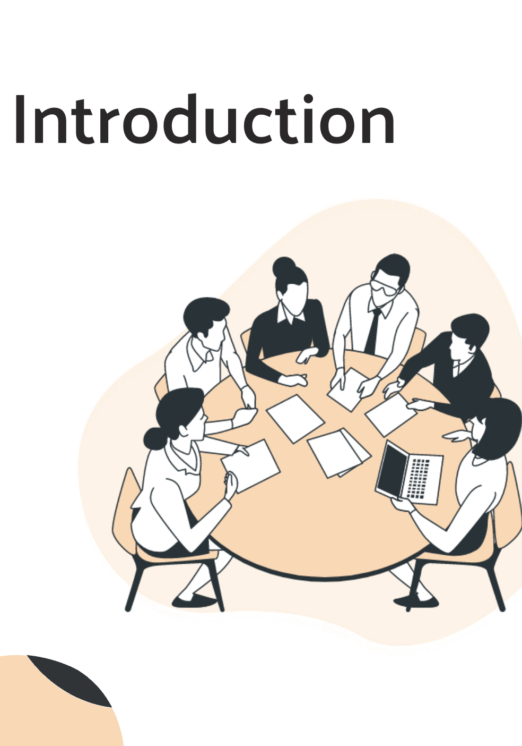

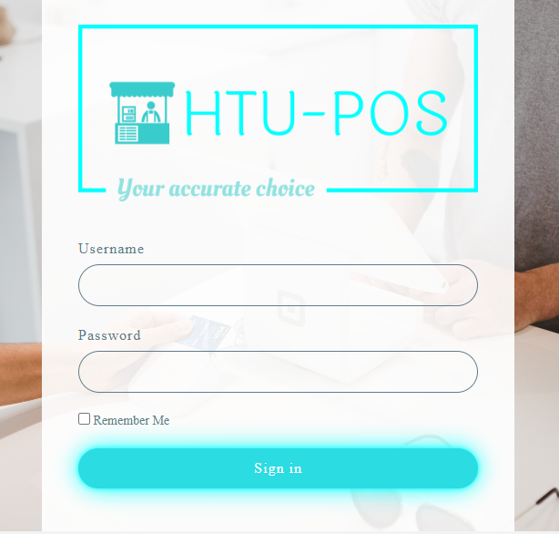
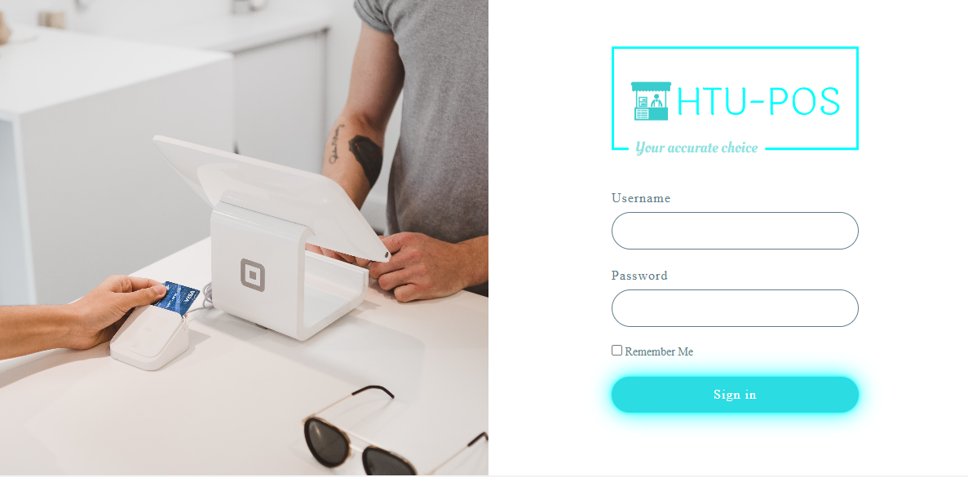
Login Page
Notes:
After clicking the login button this page will appear all designed with css and it’s responsive

Slide 10
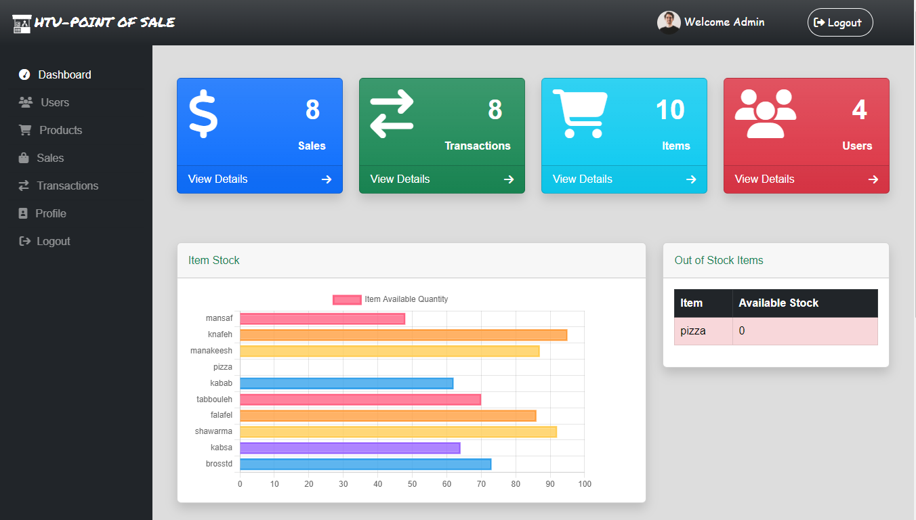
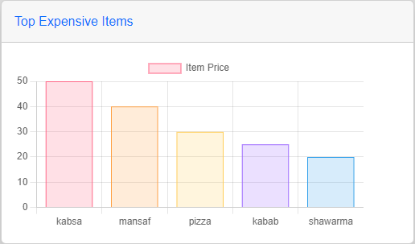
Admin Dashboard
Notes:
Admin informative dashboard contains the following information: Total sales, Total transactions, Total items number, Total users, chart represents top five expensive items to buy, another chart represents items available quantity, and table of out of stock items. To help business owners on making business decisions

Slide 11
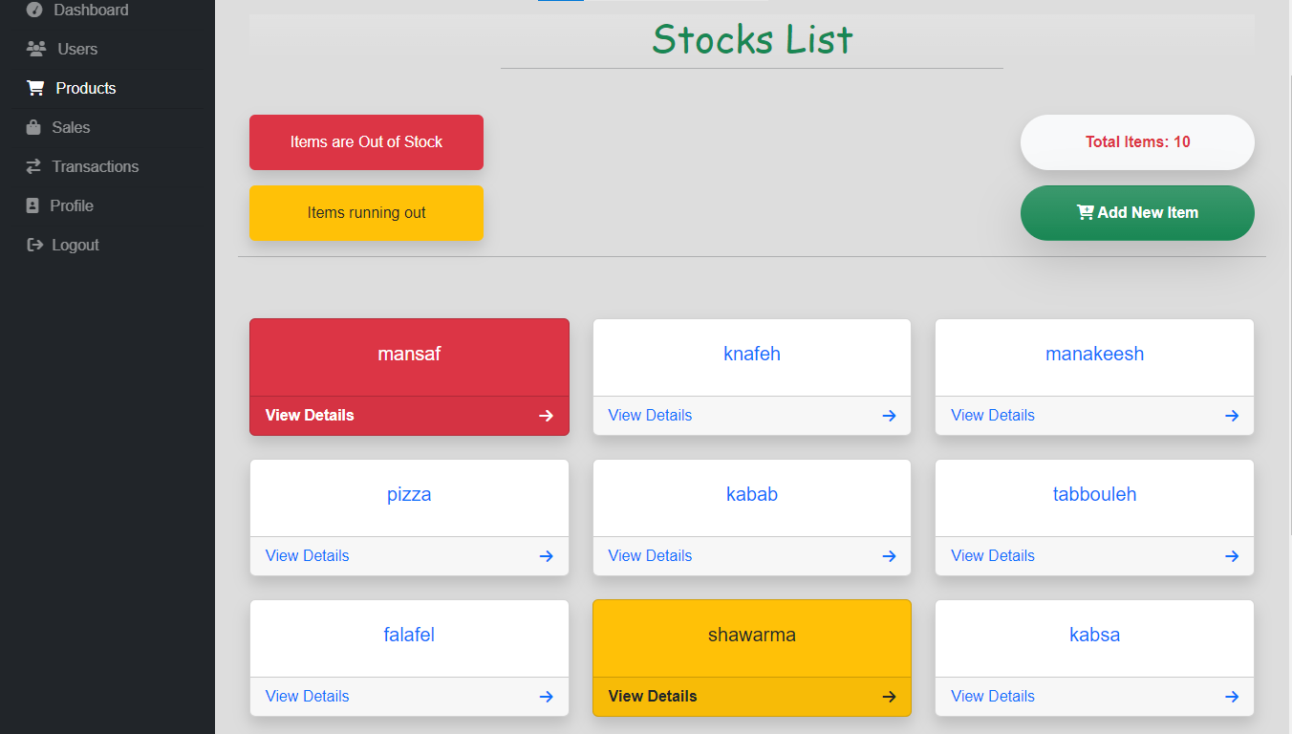
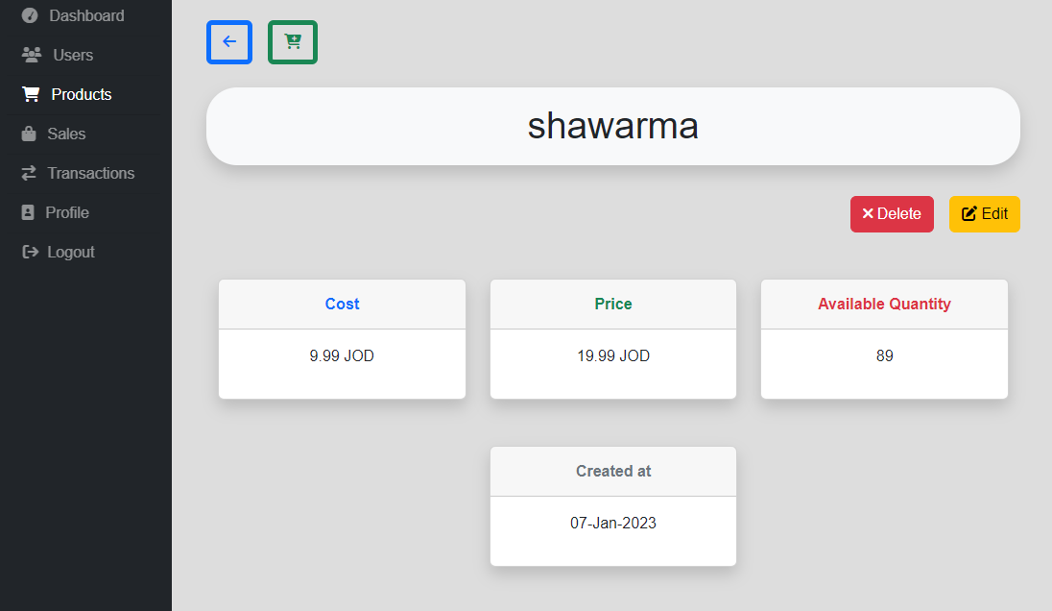
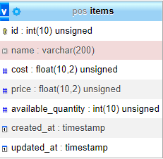
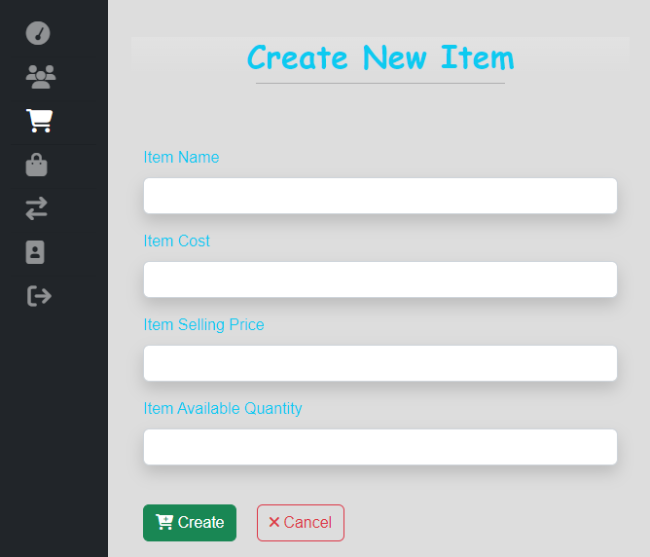
Stocks management pages
Item details
Items list page
Item attributes
Create new Item page
Notes:
the procurement manger can access these pages to check all items, add new items to the inventory or update delete item. Each item has … (columns, fields, attributes )in the db

Slide 12
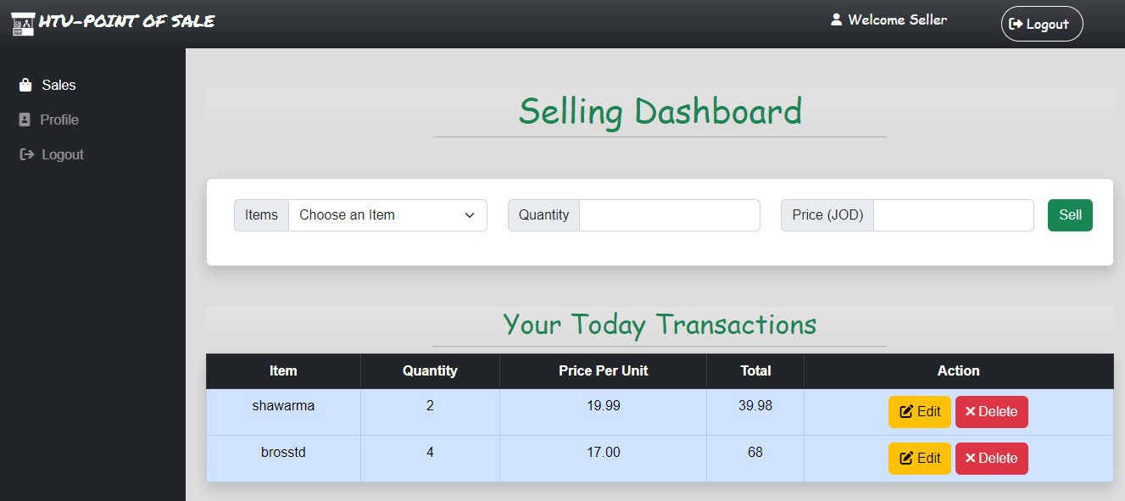
Selling Dashboard
Notes:
the seller user can access this page each time a customer buys a product or service, they’re completing a point of sale transaction. This is the moment when you officially make a sale. this page is developed using AJAX and have an API to support the AJAX requests. contains selling form with item name and item quantity.. There is a list in the same page for all the transactions that has been made today by the current logged in user. The seller can edit or delete each transaction on this list directly using action buttons.

Slide 13
Selling Dashboard Important Note!
when we want to make a new transaction (selling products):
New Item available quantity (in Items table) = Item full available quantity - sold (required) quantity in this transaction.
when we want to update a transaction by increasing or decreasing quantities:
Item full available quantity (in Items table) = The remaining quantity of this item (in Items table) + sold item quantity in this transaction ± updated (new desired) quantity .
when we want to delete a transaction.
Item full available quantity (in Items table) = The remaining quantity of this item (in Items table) + sold item quantity in this transaction.
Notes:
Here In Selling dashboard we have to pay attention to an important mathematical equations between tow tables transactions and items. To make the selling process organized, synchronized, and accurate.

Slide 14
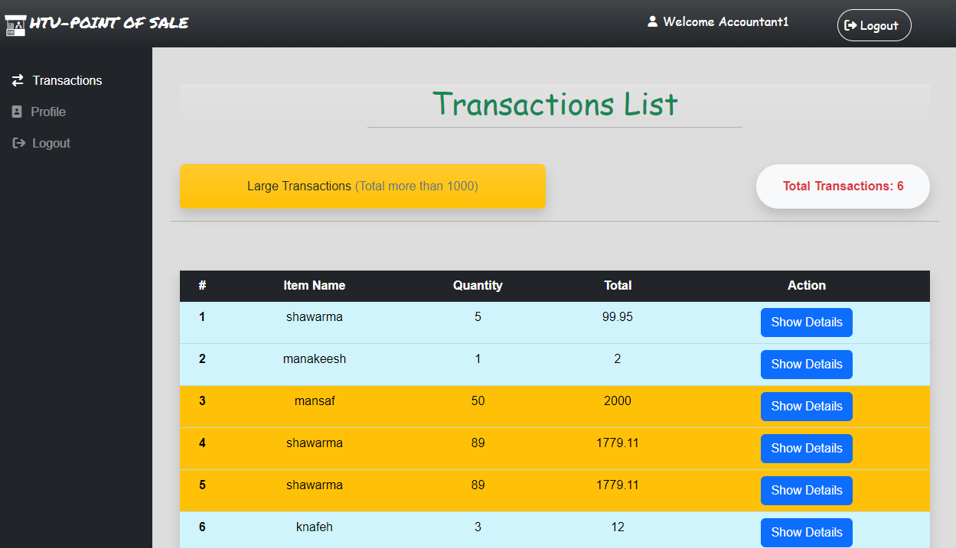
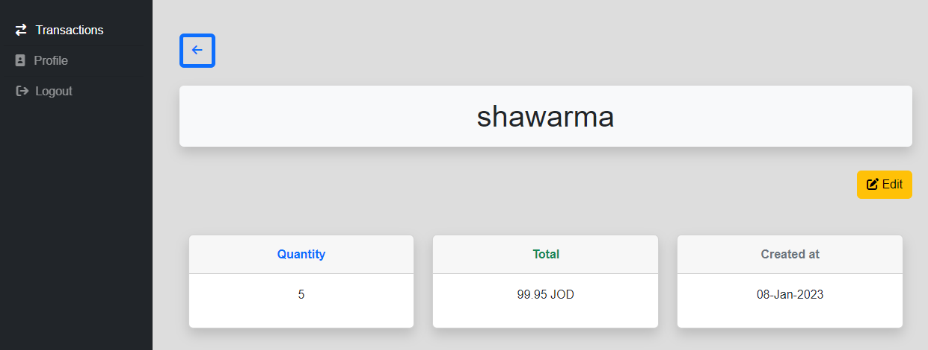
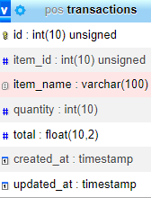
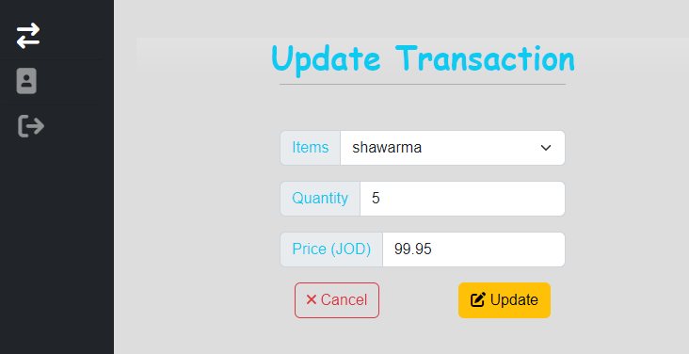
Transactions management pages
Single transaction details
All transactions page
Transaction attributes
Update transaction page
Notes:
The Accountant user can access these pages to check all transactions or update a specific transaction .

Slide 15
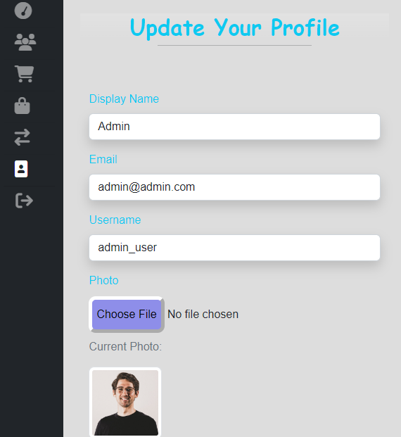
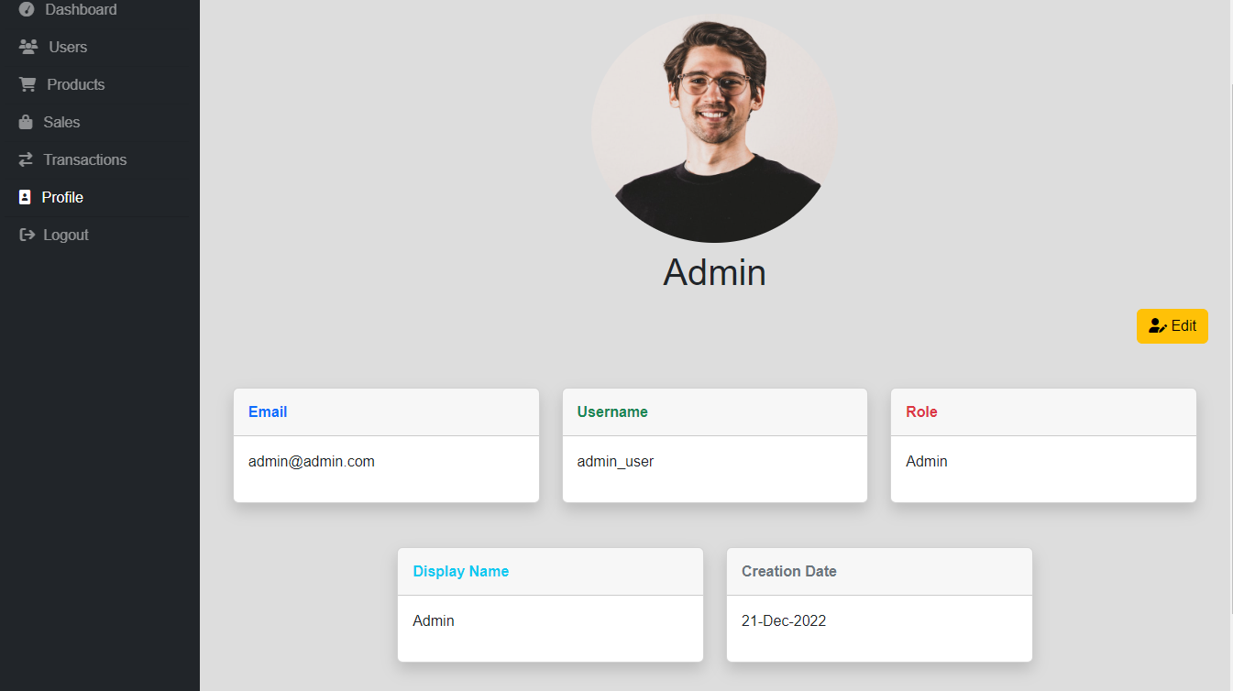

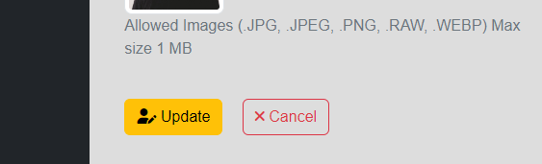
Profile page
User profile page
Update profile info
Notes:
each user has a Profile page which contains user info and they can update their profile info (display name, email, user name, and uploading a profile photo if they want).

Slide 16
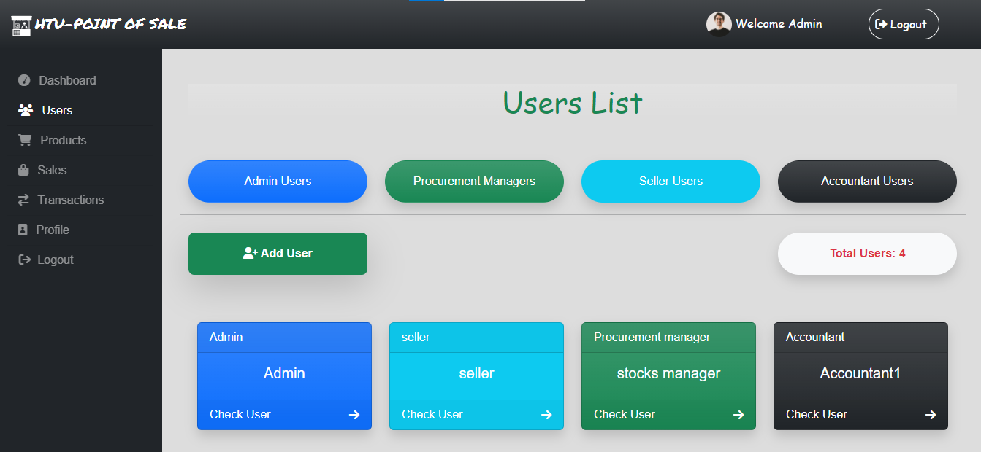
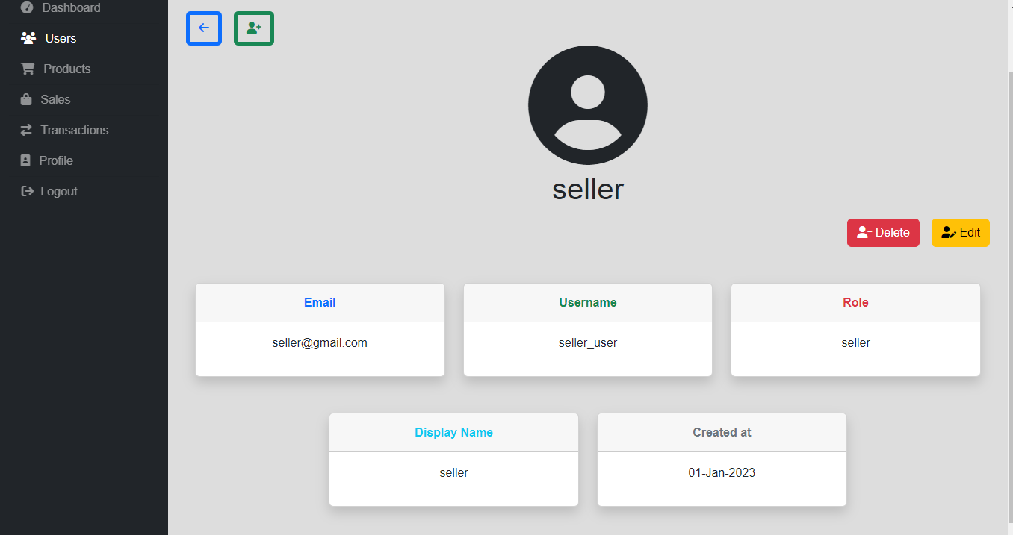
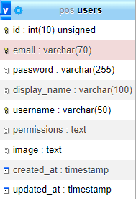
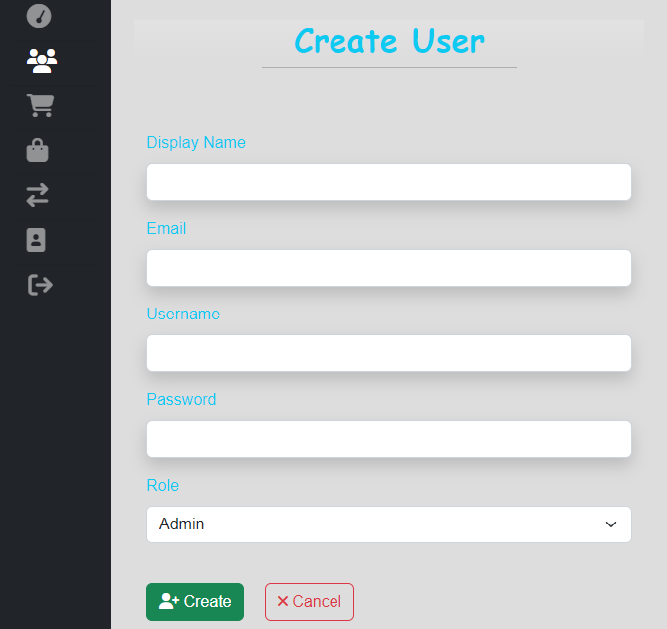
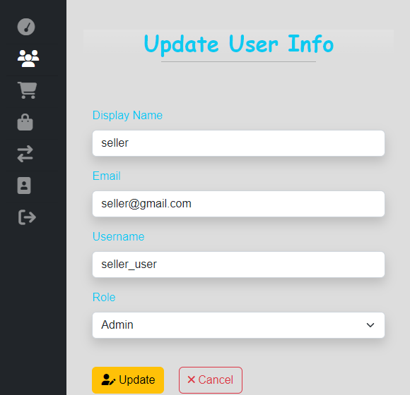
Users management pages
Single user details
Users List page
User attributes
default: null
Add new user
Update user info
Notes:
the admin can access these pages to show all users, add new users to the system or update user info and delete user. Each user has … (columns, fields, attributes )in the db, the image is not required if the user doesn’t upload a profile photo; the profile icon will appear

Slide 17

Security Aspects of HTU-POS
Cross-site scripting (XSS)
SQL injections
Passwords are not easy to read: All passwords in this web app are hashed and encrypted via the strongest encryption algorithms. Nobody can see your password even the admin.
All forms in this web app have both front-end and back-end validation.
Notes:
my web application is completely safe from XSS attacks which is a client-side vulnerability that targets application users, and SQL injections which is a server-side vulnerability that targets the application database

Slide 18

Conclusion
The HTU-POS web application provides businesses with a comprehensive set of features that can increase their efficiency and profitability.
Here in this project, I used for front-end web development (HTML5, CSS3, Bootstrap, Js, jQuery library) and for back-end (PHP as server-side programming language and MySQL as RDBMS).
Notes:
Thank you so much for your interest and attention. special thanks to my instructors and special thanks to the organizers of this program. If anyone has any questions, I will be happy to answer them.

Slide 19

Thank You!

